Slide 1
LHC magnet circuits: ELQA & recommissioning after YETS 22/23 Arjan Verweij on behalf of ELQA and MP3 Thanks as well to the HNINP collaboration, M. Janitschke, M. Solfaroli, and Christoph Obermair TE-TM, 3 April 2023
Arjan Verweij, TE-TM, 3 April 2023

Slide 2
Intro
We continuously try to improve our understanding of the SC circuits and possible non-conformities by using better models, tests and diagnostics:
Improved test analysis (especially for quenches), using notebooks
Improved Transfer Function Measurements (TFM)
Regular Fast Power Abort (FPA) tests with QPS snapshots
Improved modelling (e.g. including the effect of the beam screen)
Improved statistics and Machine Learning techniques
Arjan Verweij, TE-TM, 3 April 2023

Slide 3
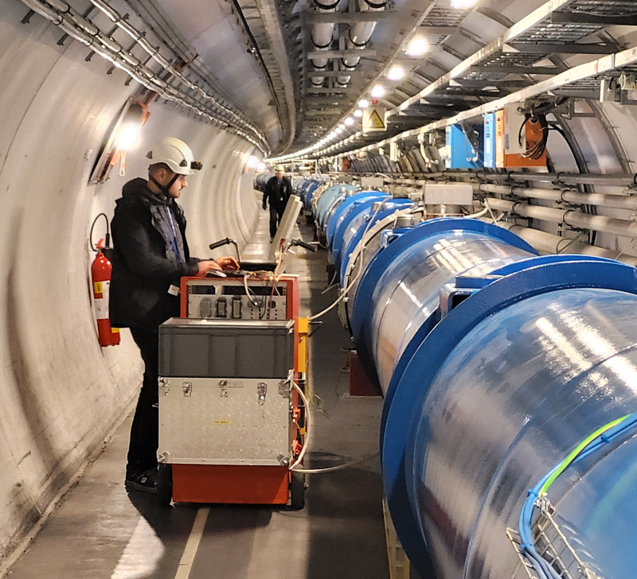
ELQA during YETS 22/23
Limited ELQA campaign:
HV tests on all 13 kA circuits + DC cables connection (1 day per sector)
HV tests on DFBLC in P3 (S34), 22 600-A circuits, +DC cables connection (2 days), following recommendation of the ELQATE TF.
Tunnel validation of ELQA TP4 mobile test benches after maintenance, replacement of some devices and upgrades
Resources HNINP: 20 person-weeks (also for activities on next slide)
Arjan Verweij, TE-TM, 3 April 2023

Slide 4
ELQA during YETS 22/23
Diagnostics on RCBXxx.R2 circuits at 20 K, see slide 5 (details presented at MP3 meeting 8/2/2023)
Local TFM in S78 and S34 (selected magnets), see slides 6-9
Analysis on RCBX circuits: no evidence of radiation induced change in performance
2 NC’s solving regarding temperature sensor reading:
DFBXE.L5, Current Lead #4, EDMS 2872611
DFBXH.R8 Current Lead #5, loose contact at the level of Proximity Equipment / Cryogenic instrumentation cable.
DC cables disconnection/reconnection to allow the repair of water-cooled cable not connected on top of RQX.L5 power converter.
Change from High- to Low-Field Quench Heater on dipole A18L1 (magnet ID=1043) triggered by the Quench Heater discharge tests (see later)
Arjan Verweij, TE-TM, 3 April 2023

Slide 5
ELQA during YETS 22/23
Diagnostics on RCBXxx.R2 circuits before and after the first additional thermal cycle on S23
C jump 50 nF → 170 nF (@ 10 kHz):
Low C on 15 March 2021 (and before)
High C on 14 Sep 2021 (and after)
Must be in the cold part
Not due to V-tap cables
Effect of measurement equipment is excluded
We don’t know the reason (yet) but will keep monitoring
Arjan Verweij, TE-TM, 3 April 2023

Slide 6
Measurement of the complex impedance of the magnets in the RB chain from 1 Hz to 100 kHz We expect to see the effect of SC magnetization, inter-filament and inter-strand coupling currents, eddy currents (wedges, beam-screen, other metallic components). Question: Is such a measurement accurate enough to see a (low-resistance) inter-turn short? If „Yes“, then we could monitor the TF on each magnet over time (e.g. once per year) If we find a possibly defective magnet then we could: - reduce the probability of quenching it during operation by reducing BLM thresholds - exchange it at the earliest convenient occasion Tests performed so far: - First type test in 2021 in S78 at 1.9 K - Various tests on a single dipole magnet in SM18 during YETS 22/23 - Second type test in Feb 2023 mainly in S78 at 1.9 K with new configuration
Transfer Function Measurements at cold (TFM)
Arjan Verweij, TE-TM, 3 April 2023

Slide 7
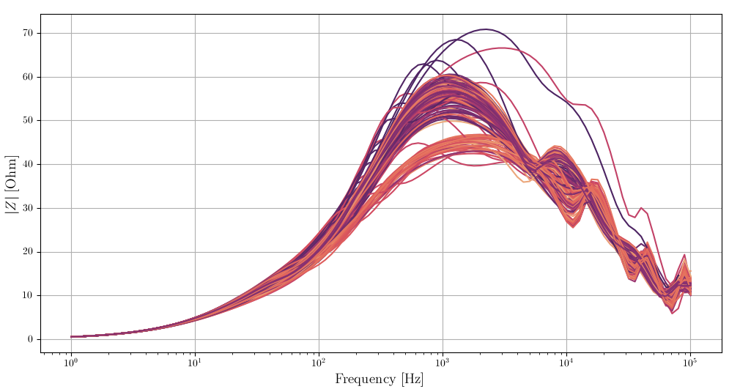
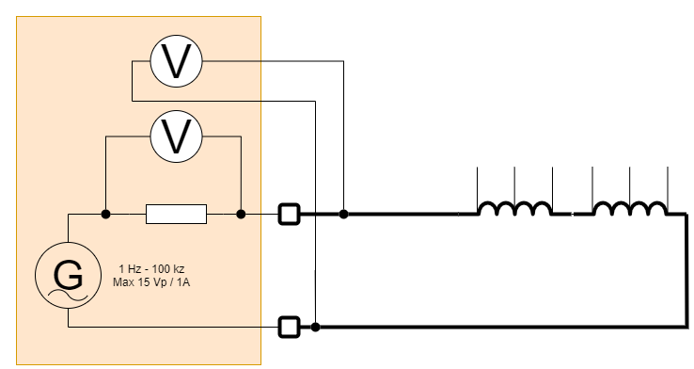

Transfer Function Measurements (TFM)
Set-up in 2021
Ap-1
Ap-2
Conclusion:
Lots of scatter among magnets made by the same manufacturer, using very similar cables and other components.
Large bias from the rest of the magnet chain.
Amplitude constraint due to 100 Ω parallel resistance in IFS box.
Arjan Verweij, TE-TM, 3 April 2023

Slide 8
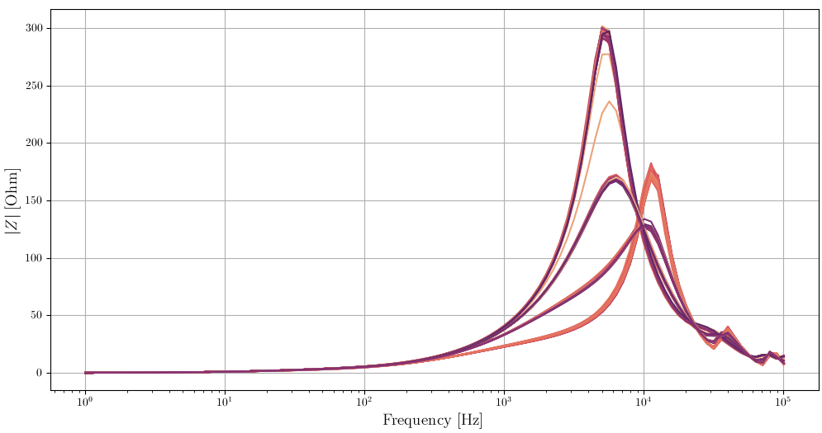
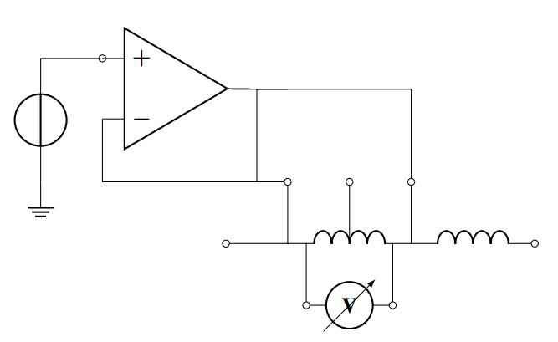
Transfer Function Measurements (TFM)
New set-up (2023)
Isolation amplifier
Conclusion:
- Almost no bias from rest of the magnet chain
- 100 Ω parallel resistance excluded
- Increased precision and clear grouping of curves
Arjan Verweij, TE-TM, 3 April 2023

Slide 9
Transfer Function Measurements (TFM)
1:
ANS and NOE (<3030)
2:
ALS (<1055)
3:
NOE (>3030)
4:
ALS (>1055)
5:
C14L8=ALS 1519 (Refurbished)
Small outliers (below group 1, above group 4): magnets at the end of the chain
1
5
3
2
4
Reproducibility based on SM18 tests: much better than 0.1 %
Arjan Verweij, TE-TM, 3 April 2023

Slide 10
Powering tests: main changes
Added QH firing on RB/RQ at 300 V and 900 V
Added QH firing on IPD/IPQ/IT at 900 V
Reduced the HWC current in the MCBX in Pt 1 and Pt 5
Reduced the HWC current in the RCOSX3, RCOX3, RCSX3, RCTX3 in Pt 1 and Pt 5
Replaced test PNO.a7/c4 by test PLI2.e3 for IPQ’s to minimize probability of quenches
Performed Fast Power Abort tests in all RB circuits at 2 and 11 kA
Upgraded QDS for the four RD1 circuits (Pt-2 and Pt-8)
DC cables of IT in Pt 5 fixed
Arjan Verweij, TE-TM, 3 April 2023

Slide 11
Training quenches during HWC campaign
RB | 1 (at 11588 A) | A22L3 (1409), + 3 fast sec. quenches
RQ | 0
IT | 0
IPD | 0
IPQ | 0
600 A | 7 | In 6 different circuits
Powering tests
All circuits passed the tests (10770 in total!!!) and reached the planned commissioning currents (except some 80-120 circuits).
See talk Matteo at LMC 22/3/2023 for the organisational aspects of the campaign.
Known circuits with possible inter-turn short in the magnet
RCBCV7.L2B2
RCBYH4.R8B1
RCBYVS4.R8B1
RCBYHS5.R8B1
RCBCV9.L8B2
RCBYV5.L4B2
RCBYHS4.L5B1
RCBCV8.L1B2
New circuits with possible inter-turn short in the magnet
RCBCV6.L8B1
RCBCH7.L8B1
RCBYV5.R4B1
RCBYH6.L4B2
RCBCH5.R1B1
RCBYH4.L2B2
RCBYHS4.R2B1
For all these 80-120 A circuits we reduce nominal current since high current is not needed for optics
E. Ravaioli, A. Verweij, M. Wozniak, "Analysis of an internal electrical short in an LHC orbit-corrector magnet with a 3D multiphysics simulation", ASC 2022.
Arjan Verweij, TE-TM, 3 April 2023

Slide 12
FPA tests
2 slides still to be added
Arjan Verweij, TE-TM, 3 April 2023

Slide 13
FPA tests
2 slides still to be added
Arjan Verweij, TE-TM, 3 April 2023

Slide 14
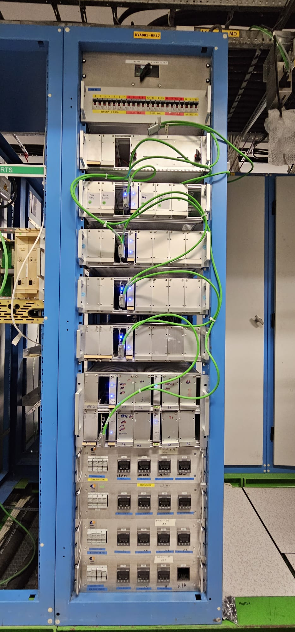
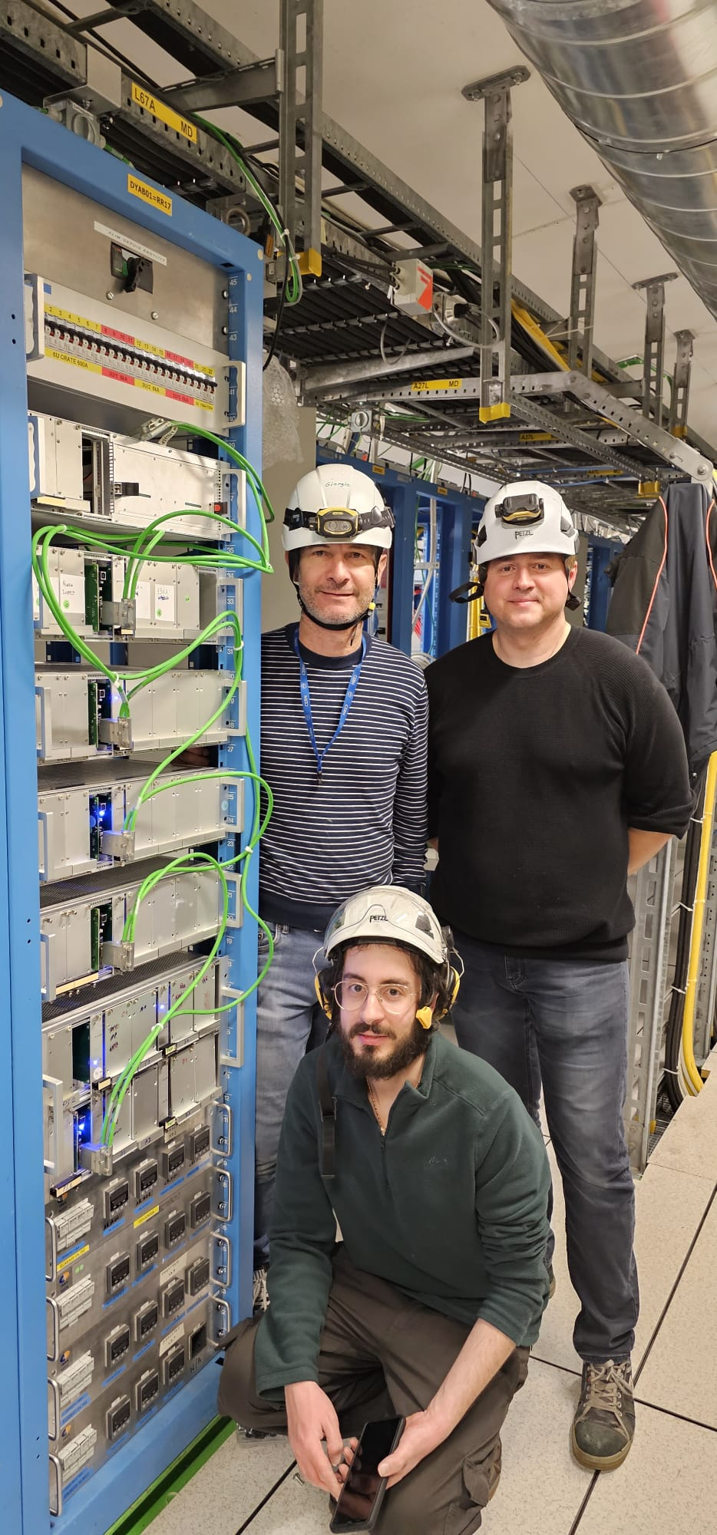
Current Lead Heating System (CLHS) upgrade
At the end of Run-3 we observed many radiation-induced issues in the CLHS.
The upgraded controllers, radiation tolerant, for the CLHS of the LHC have been installed in RR17 and RRR17 (IP 1 Left and Right) (with help from MPE-EP).
We have installed, per RR:
Power distribution crate
Remote reset unit crate
Controller crate for 13 kA and 120 A circuits
3 Controller crates for 6 kA circuits
1 Controller crate for 600 A circuits
All current leads located in RR13 and RR17 (55 in each RR) are now connected to the upgraded CLHS, regulating as expected.
Arjan Verweij, TE-TM, 3 April 2023

Slide 15
Final remarks
QH analysis has been finished and resulted in one non-conform QH circuit (most likely in the cold part).
Analysis of the FPA and the TFM diagnostics is not yet finished. Results will be discussed in the MP3.
Then the MP3 will give recommendations on:
The frequency of QH firings (e.g. once a year), and concerned circuits, and applied voltage levels (300 V and/or 900 V).
The frequency of FPA tests in the RB circuits, and test conditions (current level and ramp rate).
The need to perform a reference TFM in all sectors, and on which magnets (MB, MQ, IT, IPQ, IPD).
The frequency of regular TFM measurements.
Additional diagnostics comes of course with additional need for resources and time. This has to be carefully scheduled. Especially TFM measurements take a lot of resources (15 person-days per sector)
Arjan Verweij, TE-TM, 3 April 2023

Slide 16
Final point (from HWC after LS2)
Machine learning techniques revealed one case of an RB quench with suspicious voltage spikes on U_diode (brd A and B)
Quench of 20/4/2021 at about 11780 A. Position: MB.B28R3 Magnet ID: 2421
Arjan Verweij, TE-TM, 3 April 2023

Slide 17
Zoom
Analysis ongoing. For the moment we have not been able to reproduce such spikes by simulations assuming various fault scenarios.
Arjan Verweij, TE-TM, 3 April 2023

